Slide 1
Instacart Order Analysis
Group Members:
Syed Zarif
Muhammad Faris
Athirah Zahidah

Slide 2
AGENDA
Project Overview
Business and data understanding
Exploratory data analysis
Findings
Business insights and future plan

Slide 3

PROJECT OVERVIEW
Online sellers may faced supply chain management.
Shortage or oversupply products.
Use transactional data to develop models- predict which products a user will buy again, try for the first time, or add to their cart
Provide recommendations based on history.
Grocery Order and Delivery App

Slide 4

Objective and Goals
To predict which product will be reordered by the customer.
Able to find the most and least ordered products.
Estimate the ideal time when to restock items.

Slide 5

BUSINESS UNDERSTANDING
Online grocery delivery company.
US and Canada.
A platform for grocery retailers to sell their products.
Implements sharing economy-based business model.
Provides hyper local on-demand grocery delivery by connecting customers with personal shoppers.
Reduce shortage or oversupply products.

Slide 6
DATA UNDERSTANDING
6 files
Departments - food categories
Aisles - food sections
Products - 49688 products name
Orders - orders track
Order Products Prior - Order history of every user
Order Products Train - Current order data of every user which contains only 1 order per user

Slide 7
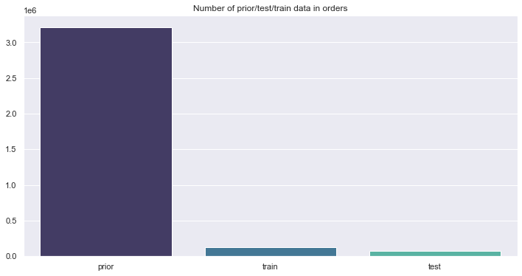
Exploratory Data Analysis
MARS
NEPTUNE
JUPITER
SATURN
Below graph shows the total of categorize data for prior, train & test from order dataset

Slide 8
Exploratory Data Analysis (contd.)
MARS
NEPTUNE
A study have been conducted in order to analyze the customer behavior on the ideal time that customer often order from Instacart.
Categorize the total order based on hours of the day
Separate the total order by day of the week
Identify the most ideal time based total order for hours of the day against days of week

Slide 9
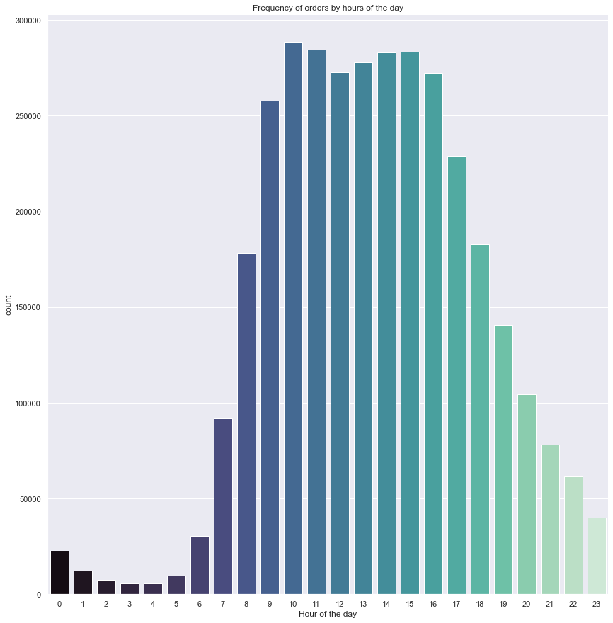
Frequency of customer order based on hours of the day
Frequent order: 10am - 3pm
Limited only based on hours
Order Prior Dataset

Slide 10
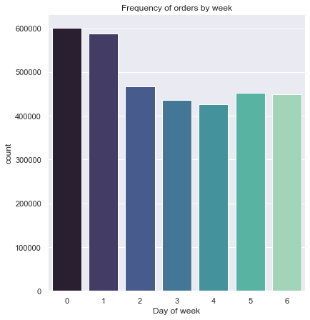
Frequency of customer order by week
0 to 6: Sunday - Saturday
Often order: Sunday and Monday
least order: Thursday

Slide 11
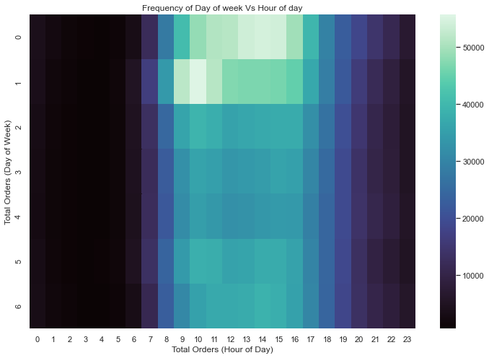
The ideal hour and day of the purchase
Most order: 10am until 3pm which on Sunday & Monday
Future planning: seller able to predict which time they can restock their products
Plan to minimize the impact on their operation by avoiding peak hour.

Slide 12
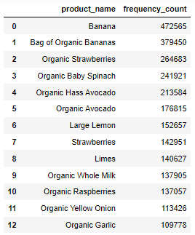
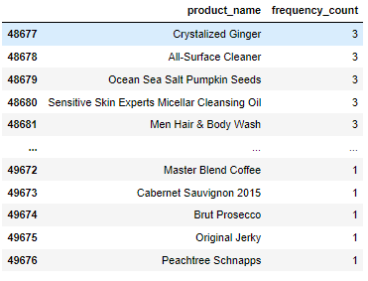
Most and least selling products
Business unit: increase their sales and reduce the amount of unsold product by focused on restocking based on demand

Slide 13
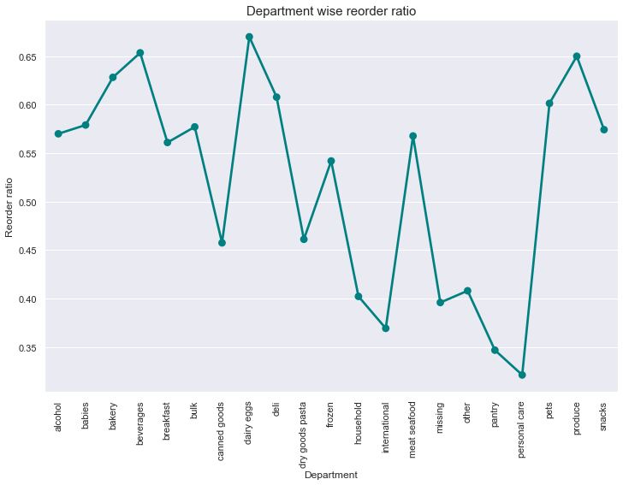
Reordered Products by department
Identify the ratio of reordered product based on department.
Identify which department have the highest and lowest tendency of reordered product.
Order Train Dataset

Slide 14
Current Approach to Data Modeling
A Binomial Logistic Regression is designed for two-class problems.
Hence, it can be used for the classification tasks whether the products will be reordered or not.
Process of the data modelling:
Prepare the final data (merge all important features) for the modeling.
Set variable to be predicted which is ‘reordered’
Perform 70/30 data split.
Build Logistic Regression model

Slide 15
MACHINE LEARNING MODEL RESULTS
MARS
VENUS
Probability for each row in the test set to be ordered are as follows:
array([0.59, 0.54, 0.56, ..., 0.520, 0.49, 0.69]).
True and False of whether the probability passed the threshold of 0.5:
array([ True, True, True, ..., True, False, True]).
Accuracy score of Logistic Regression Model:
0.59711930589861 ~ 59.7%

Slide 16
KEY INSIGHTS FOR BUSINESS
Consumers tend to order products periodically
Some people become grocery shopper to get side income
Stores take opportunity to advertised their products- membership fees

Slide 17
NEXT ACTION POINTS FOR BUSINESS TEAMS
Promotional and marketing campaigns targeting specific customers during peak time.
The most and least product graph can be referred in order to do planning to increase the sale and to minimize risk of unsold inventory.
Improve the productivity to restock the product based on the target time to minimize the impact on business and prepare stock before peak hour.
Focus on smaller scope to improve sale on each of the area based on reorder ratio.

Slide 18
KEY POINTS OF IMPROVEMENT
Add more new features to help generalize better on the test dataset to achieve better results.
Make comparison for the model approach.
2
1
3
Try to apply multinomial algorithms for better utilization of datasets.

Slide 19
REFERENCES
https://rpubs.com/MohabDiab/482437
https://suniljammalamadaka.medium.com/instacart-market-basket-analysis-ac12e586dcc7
https://www.apurple.co/instacart-business-model/

